Slide 1

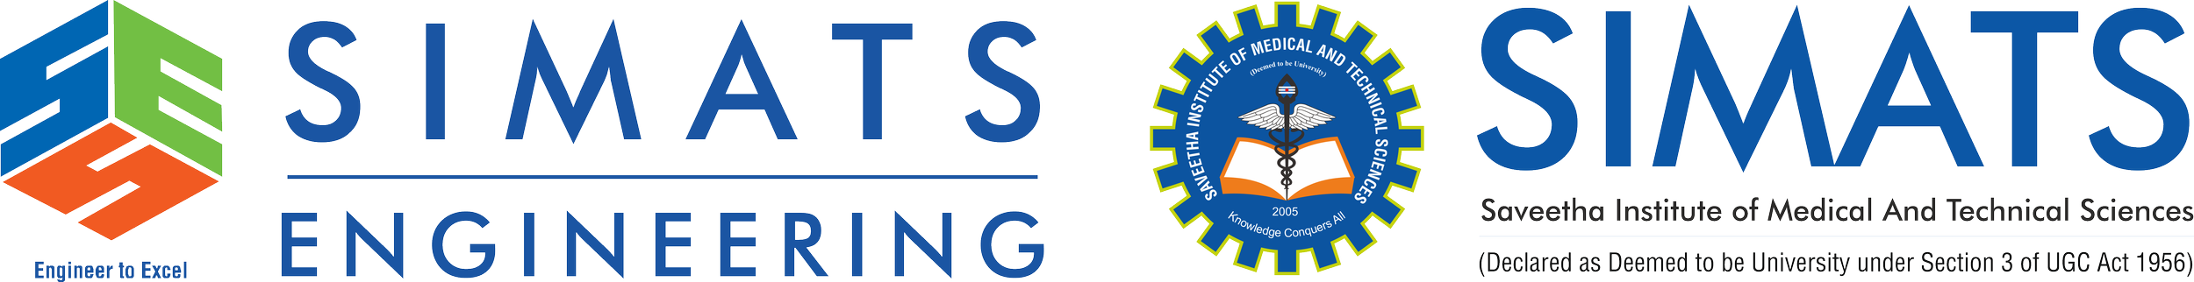


Comparison Between File-Based Systems and DBMS
Healthcare System Case Study
Course CSA0506 - Database Management
Presented By :
Nitheesh kumar P (192524051)

Slide 2



CSA0506 - Database Management
Introduction: Core Concepts
What is a File-Based System?
What is DBMS?
A traditional approach where data is stored in separate, isolated files.
A software system that stores and manages data in a centralized database.
•
Each department maintains its own independent records.
•
Provides an interface between users, applications, and the data.
•
Data is often managed by specific application programs.
•
Allows secure, fast, and efficient data management.
•
Ensures data integrity and concurrent access control.
•
Lacks centralized control and coordination.

Slide 3
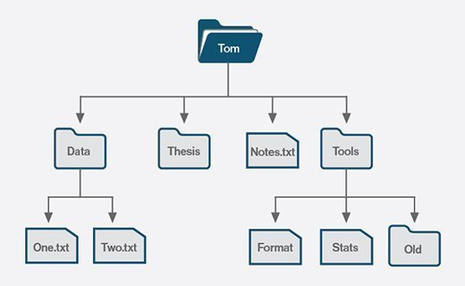
Working of File-Based System
The Decentralized Approach
In a healthcare setting using a file-based approach, information is highly fragmented.
Separate Files: Patient admissions, pharmacy, laboratory, and billing each maintain distinct files.
Duplicate Data: A patient's basic details (name, address) are repeated across multiple departmental files.
Difficult Maintenance: Updating a patient's phone number requires manual changes in every department's file system, leading to inconsistencies.

Slide 4
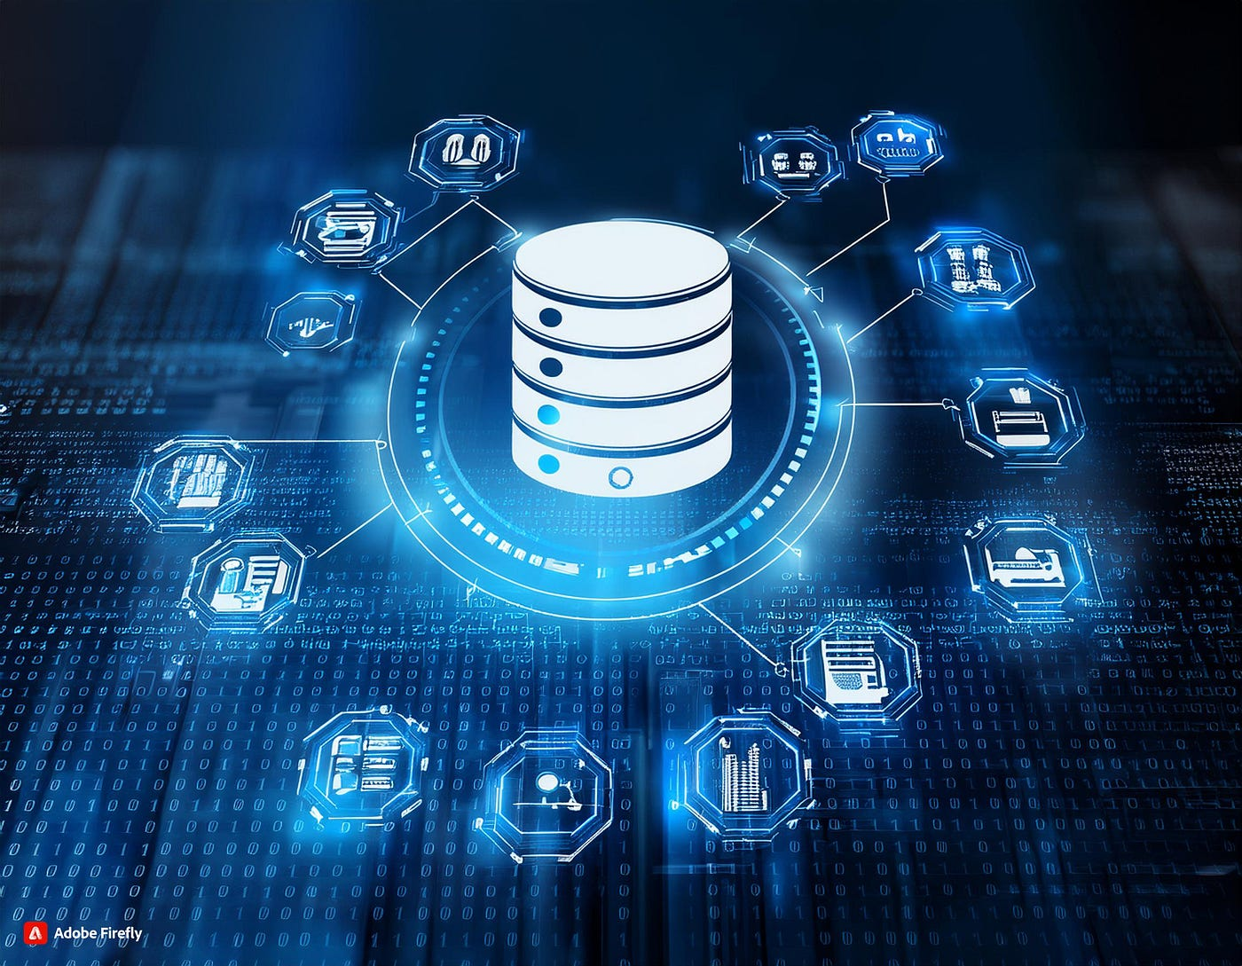
Working of DBMS
The Centralized Solution
A DBMS integrates data into a single, logical structure accessible by all authorized users.
One Centralized Database: All patient records, test results, and billing info reside in one secure location.
Shared Access: Doctors, nurses, and admin staff access the same unified patient profile.
Instant Updates: If admission updates a patient's address, the pharmacy and billing departments see the change immediately.

Slide 5



Case Study: Healthcare System
Scenario: Patient Updates Contact Info
File-Based System
DBMS Approach
Process: The patient informs the receptionist. The receptionist updates the 'Admissions' file.
Process: The receptionist updates the number in the central patient profile interface.
The Problem: The Pharmacy, Lab, and Billing files still hold the old number. If a critical lab result requires immediate contact, they might call the wrong number. Data becomes inconsistent.
The Solution: Because there is only one central record for that patient, the Pharmacy, Lab, and Billing modules instantly retrieve the new number. Data consistency is guaranteed.

Slide 6

Feature Analysis
File-Based vs. DBMS
Feature | File-Based System | DBMS
Storage | Separate, isolated files | Centralized, integrated database
Data Redundancy | High (Data is duplicated across files) | Low (Data is stored centrally)
Data Consistency | Poor (Updates must be manual across files) | High (Updates reflect universally)
Security | Basic (OS-level file permissions) | Strong (Authentication, role-based access)
Data Retrieval | Slow and complex (Requires specific programs) | Fast and flexible (Using query languages like SQL)
Backup & Recovery | Difficult (Manual backups required) | Easy (Built-in automated recovery tools)

Slide 7

Summary
Conclusion & Benefits of DBMS
Reduces Data Redundancy: Minimizes wasted storage space.
Maintains Data Consistency: Single source of truth.
Faster Data Retrieval: Optimized querying engines.
Better Security: Granular access controls.
Multi-User Access: Concurrent usage without conflicts.
Backup & Recovery: Safeguards against data loss.
Conclusion: A Database Management System (DBMS) is vastly more efficient and robust than a traditional file-based system.
By eliminating duplicate data, improving accuracy, and enhancing security, DBMS has become the standard for managing critical information in hospitals, universities, banks, and modern businesses.

